Slide 1
ICS 241 Databases
P. Radha Krishna
pisipati.radhakrishna@gmail.com

Slide 2
Course Details
ICS241 Databases
Timings:
8:30-10AM Wednesday & Saturday
Text Book:
Elmasri & Navathe, Fundamentals of Database Systems

Slide 3
1 03MMB01 xxxxxxx 11 19 16 17 36 44 80 A 2 03MMB02 Xxxx xxxxxx 8 18 17.5 17.5 35.5 49 84.5 A 3 03MMB03 xxxxxxxx 9 16 18 18 36 44 80 A 4 03MMB04 qqqqqqqqqqq 11.5 19 18.5 18 38.5 50 88.5 A 5 03MMB05 vvvvvvvvvvvvv 10 17 17.5 16.5 34 43.5 77.5 B 6 03MMB06 dddddddddd 9.5 15 17 16 33 44 77 B 7 03MMB07 ffffffffffffffff 8.5 19 16 18.5 37.5 45 82.5 A 8 03MMB08 gggggggggggggggg 6.5 19 16 17.5 36.5 44 80.5 A 9 03MMB09 Kkkk kkkkk 2.5 15 15.5 17 32 43.5 75.5 B 10 03MMB10 llllllllllllll 1.5 15 15 16 31 30 61 C 11 03MMB11 lllkkkkkkkkkkjjjjjjjjjjj 1.5 7 15 15.5 30.5 37.5 67.5 C 12 03MMB12 ggggggg 5.5 18 15 17.5 35.5 46 81.5 A 13 03MMB13 ttttttttttttttt 5 18 16 16.5 34.5 44 78.5 B 14 03MMB14 P.ppppppppppppp 8 18 15 16.5 34.5 42 76.5 B 15 03MMB15 A.Vvvvvvvvvvvvv 9 17 17.5 17.5 35 42.5 77.5 B 16 03MMB16 K.Sasasasasa 8 19 19.5 19.5 39 41 80 A 17 03MMB17 Ggggggggggggg 8 19 16 16.5 35.5 42.5 77.5 B 18 03MMB18 Didddddddd 10 19 18.5 17 37.5 47 84.5 A 19 03MMB19 Vssssssssssss 10.5 17 17 17 34 42.5 76.5 B 20 03MMB20 Mmmmmmmmmmm 3.5 13 18 15 33 36 69 C 21 03MMB21 Yrrrrrrrrrrrrr 9 15 17 16.5 33.5 40.5 73.5 B 22 02MMB08 Nnnnnnnnnnnnnn mnn 3.5 7 15 AB 22 40.5 62.5 C

Slide 4
1 03MMB01 xxxxxxx 11 19 16 17 36 44 80 A
2 03MMB02 Xxxx xxxxxx 8 18 17.5 17.5 35.5 49 84.5 A
3 03MMB03 xxxxxxxx 9 16 18 18 36 44 80 A
4 03MMB04 qqqqqqqqqqq 11.5 19 18.5 18 38.5 50 88.5 A
5 03MMB05 vvvvvvvvvvvvv 10 17 17.5 16.5 34 43.5 77.5 B
6 03MMB06 dddddddddd 9.5 15 17 16 33 44 77 B
7 03MMB07 ffffffffffffffff 8.5 19 16 18.5 37.5 45 82.5 A
8 03MMB08 gggggggggggggggg 6.5 19 16 17.5 36.5 44 80.5 A
9 03MMB09 Kkkk kkkkk 2.5 15 15.5 17 32 43.5 75.5 B
10 03MMB10 llllllllllllll 1.5 15 15 16 31 30 61 C
11 03MMB11 lllkkkkkkkkkkjjjjjjjjjjj 1.5 7 15 15.5 30.5 37.5 67.5 C
12 03MMB12 ggggggg 5.5 18 15 17.5 35.5 46 81.5 A
13 03MMB13 ttttttttttttttt 5 18 16 16.5 34.5 44 78.5 B
14 03MMB14 P.ppppppppppppp 8 18 15 16.5 34.5 42 76.5 B
15 03MMB15 A.Vvvvvvvvvvvvv 9 17 17.5 17.5 35 42.5 77.5 B
16 03MMB16 K.Sasasasasa 8 19 19.5 19.5 39 41 80 A
17 03MMB17 Ggggggggggggg 8 19 16 16.5 35.5 42.5 77.5 B
18 03MMB18 Didddddddd 10 19 18.5 17 37.5 47 84.5 A
19 03MMB19 Vssssssssssss 10.5 17 17 17 34 42.5 76.5 B
20 03MMB20 Mmmmmmmmmmm 3.5 13 18 15 33 36 69 C
21 03MMB21 Yrrrrrrrrrrrrr 9 15 17 16.5 33.5 40.5 73.5 B
22 02MMB08 Nnnnnnnnnnnnnn mnn 3.5 7 15 AB 22 40.5 62.5 C

Slide 5
Sl. No. | Student ID | Student Name |  |  |  |  |  | Major Marks ( 60 ) | Total | Final Grade
 |  |  | Unit-I ( 20 ) | Unit-II ( 20 ) | Unit-III ( 20 ) | Unit-IV ( 20 ) | Best 2 ( 40 )
1 | 03MCMB01 | xxxxxxx | 11 | 19 | 16 | 17 | 36 | 44 | 80 | A
2 | 03MCMB02 | Xxxx xxxxxx | 8 | 18 | 17.5 | 17.5 | 35.5 | 49 | 84.5 | A
3 | 03MCMB03 | xxxxxxxx | 9 | 16 | 18 | 18 | 36 | 44 | 80 | A
4 | 03MCMB04 | qqqqqqqqqqq | 11.5 | 19 | 18.5 | 18 | 38.5 | 50 | 88.5 | A
5 | 03MCMB05 | vvvvvvvvvvvvv | 10 | 17 | 17.5 | 16.5 | 34 | 43.5 | 77.5 | B
6 | 03MCMB06 | dddddddddd | 9.5 | 15 | 17 | 16 | 33 | 44 | 77 | B
7 | 03MCMB07 | ffffffffffffffff | 8.5 | 19 | 16 | 18.5 | 37.5 | 45 | 82.5 | A
8 | 03MCMB08 | gggggggggggggggg | 6.5 | 19 | 16 | 17.5 | 36.5 | 44 | 80.5 | A
9 | 03MCMB09 | Kkkk kkkkk | 2.5 | 15 | 15.5 | 17 | 32 | 43.5 | 75.5 | B
10 | 03MCMB10 | llllllllllllll | 1.5 | 15 | 15 | 16 | 31 | 30 | 61 | C
11 | 03MCMB11 | lllkkkkkkkkkkjjjjjjjjjjj | 1.5 | 7 | 15 | 15.5 | 30.5 | 37.5 | 67.5 | C
12 | 03MCMB12 | ggggggg | 5.5 | 18 | 15 | 17.5 | 35.5 | 46 | 81.5 | A
13 | 03MCMB13 | ttttttttttttttt | 5 | 18 | 16 | 16.5 | 34.5 | 44 | 78.5 | B
14 | 03MCMB14 | P.ppppppppppppp | 8 | 18 | 15 | 16.5 | 34.5 | 42 | 76.5 | B
15 | 03MCMB15 | A.Vvvvvvvvvvvvv | 9 | 17 | 17.5 | 17.5 | 35 | 42.5 | 77.5 | B
16 | 03MCMB16 | K.Sasasasasa | 8 | 19 | 19.5 | 19.5 | 39 | 41 | 80 | A
17 | 03MCMB17 | Ggggggggggggg | 8 | 19 | 16 | 16.5 | 35.5 | 42.5 | 77.5 | B
18 | 03MCMB18 | Didddddddd | 10 | 19 | 18.5 | 17 | 37.5 | 47 | 84.5 | A
19 | 03MCMB19 | Vssssssssssss | 10.5 | 17 | 17 | 17 | 34 | 42.5 | 76.5 | B
20 | 03MCMB20 | Mmmmmmmmmmm | 3.5 | 13 | 18 | 15 | 33 | 36 | 69 | C
21 | 03MCMB21 | Yrrrrrrrrrrrrr | 9 | 15 | 17 | 16.5 | 33.5 | 40.5 | 73.5 | B
22 | 02MCMB08 | Nnnnnnnnnnnnnn mnn | 3.5 | 7 | 15 | AB | 22 | 40.5 | 62.5 | C

Slide 6
Store Data Effectively
Retrieve Data Efficiently
Database
Database is a collection of data
Database is a collection of related data
Database is a collection of related data for a specific purpose

Slide 7
Course Details (Order)
1 – Introduction/Database Concepts
2 – Data Modeling
3 – Relational Model/Algebra
4– Calculus/SQL
5 – Normalization

Slide 8
Course Details
Two Projects – Database Design Project – actual dates to be announced later (on courses portal).
1 – Requirements Analysis
2 – Conceptual Design
3 – Logical Design
4 – Application & SQL

Slide 9
Course Details
Grading:
Final Exam 35 Marks
Midterm Exams 20 Marks
Projects 25 Marks
Assignments/Quizes 20 Marks
Total 100 Marks
Each assignment missed you lose 5% of assignment grade
Attendance in tutorials/labs is compulsory

Slide 10
Course Grading
Variance driven proportional grading – can be applied to a question, or component of grading, like all assignments, single assignment, etc.

Slide 11
Course Details
Academic Honesty:
Unless otherwise stated, all work submitted by you should be your own. Copying of assignments, help taken, or given in debugging of programs, or sharing of algorithms, data, and results would constitute cheating. For paper critiques, presentations, and project reports, any form of cut and paste from various on-line and off-line resources is prohibited. If there is any doubt about the appropriateness of your actions, please contact the instructor for explicit clarification. Cheating is an offence and will result in an appropriate disciplinary action against those involved.

Slide 12
Motivation For This Course

Slide 13
Database Systems
Second Largest Software Sales….
Largest?
Most application processing jobs….
Success story for Research and Development
Three Turing Awards
Bachmann (1973), Codd (1981) & Gray (1998); _ (201_)
Database systems - first course
after that distributed DBMSs, data warehousing, data mining, database design courses

Slide 14
What will you learn?
Relational Database Systems
Data Models
SQL
Database design process
Normalization
File Structures and Indexing
Query Processing and Optimization
Transaction Management
Concurrency Control and Recovery
Database Security and Authorization

Slide 15
REMEMBER ALWAYS:
Database Systems Deal with Data Stored Permanently and Managed on External Storage Devices (mainly Hard Disks).
And tend to be very large (10s of Terabytes).
<main memory database systems exist, issues different>

Slide 16
What Are Database Systems?

Slide 17
What is a Database?
Data: factual (undoubted) information used as a basis for reasoning, discussion, or calculation.
A database is a collection of related data.
Notes:
2
2
Connect to tutorial oriented presentation, and emphasize our approach

Slide 18
What is a Database?
A database has the following implicit properties:
A database represents some aspect of the real world (mini-world or Universe of Discourse (UoD)).
A database is a logically coherent (associated, related) collection of data with some inherent meaning.
A database is designed, built and populated with data for a specific purpose.
It has an intended group of users and some preconceived (already thought of) applications in which these users are interested.
Notes:
2
2
Connect to tutorial oriented presentation, and emphasize our approach

Slide 19
Database System
A database management system (DBMS) is a collection of programs that enables users to create and maintain a database.
Defining Databases
involves specifying the data types, structures, and constraints for the data to be stored in the database.
Constructing Databases
storing the data itself (populating) on some storage medium that is controlled by the DBMS.
Manipulating Databases
querying the database to retrieve specific data, updating the databases to reflect changes to mini-world, and generating reports from the data.
Database + DBMS software = Database System
Notes:
2
2
Connect to tutorial oriented presentation, and emphasize our approach

Slide 20
Simplified Database System
USERS/PROGRAMMERS
DATABASE
SYSTEM
APPLICATION PROGRAMS/
QUERIES
DBMS
SOFTWARE
SOFTWARE TO PROCESS QUERIES/ PROGRAMS
SOFTWARE TO ACCESS
STORED DATA
Stored Database
Definition
(Meta-Data)
Stored Database
Notes:
2
2
Connect to tutorial oriented presentation, and emphasize our approach

Slide 21
Example of a Database
Consider a part of a University environment
We need data about:
STUDENTs
COURSEs
SECTIONs (of COURSEs)
(academic) DEPARTMENTs
INSTRUCTORs
The above data is related as follows:
SECTIONs are of specific COURSEs
STUDENTs take SECTIONs
COURSEs have prerequisite COURSEs
INSTRUCTORs teach SECTIONs
COURSEs are offered by DEPARTMENTs
STUDENTs major in DEPARTMENTs
Notes:
2
2
Connect to tutorial oriented presentation, and emphasize our approach

Slide 22
Example Database
Notes:
2
2
Connect to tutorial oriented presentation, and emphasize our approach

Slide 23
Characteristics of the Database Approach
A number of characteristics distinguish the database approach from the traditional approach of programming with files.
In traditional file processing, each user defines and implements the files needed for a specific application.
In the database approach, a single repository of data is maintained that is defined once and then is accessed by various users.
Self describing nature of a Database System: the database system contains not only the database itself but also a complete definition (meta-data) of the database which is stored in the system catalog.
Notes:
2
2
Connect to tutorial oriented presentation, and emphasize our approach

Slide 24
OS and Database
Physical Database
Users
DBMS
OS

Slide 25
Characteristics of the Database Approach
Insulation between programs and data, and Data Abstraction: the structure of data files is stored separately from the access programs (program-data independence).
The characteristic that allows program-data independence is called data abstraction. A DBMS provides users with a conceptual representation of data that does not include many of the details of how the data is stored.
Support for multiple views of the data
Sharing of Data and Multiuser Transaction Processing
A typical database management system has all the above characteristics, whereas a typical file processing system does not.
Notes:
2
2
Connect to tutorial oriented presentation, and emphasize our approach

Slide 26
Actors (Users) on Scene
The persons whose jobs involve the day-to-day use of a large database
Database administrators
Database Designers
End Users: Casual, Naive, Sophisticated and Stand-alone users
System Analysts and Application Programmers
Workers Behind the Scene:
DBMS Designers and Implementers
Tool Developers
Operators and Maintenance Personnel
Notes:
2
2
Connect to tutorial oriented presentation, and emphasize our approach

Slide 27
Intended Uses of a DBMS
Controlling Redundancy
Restricting Unauthorized Access
Representing complex relationships among data
Enforcing Integrity constraints
Providing Backup and Recovery
Providing multiple User Interfaces
Persistent Storage for Program Objects and Data Structures
Database Interfacing Using Deduction Rules
Notes:
2
2
Connect to tutorial oriented presentation, and emphasize our approach

Slide 28
Intended Uses of a DBMS
Implications of the Database Approach
Reduced application development time
Flexibility
Available up-to-date Information
Economics of Scale
Notes:
2
2
Connect to tutorial oriented presentation, and emphasize our approach

Slide 29
When not to use a DBMS
Main costs of using a DBMS:
High initial investment and possible need for additional hardware.
Overhead for providing generality, security, recovery, integrity, and concurrency control.
When a DBMS may be unnecessary
If the database and applications are simple, well defined, and not expected to change.
If there are stringent real-time requirements that may not be met because of DBMS overhead.
If access to data by multiple users is not required.
Notes:
2
2
Connect to tutorial oriented presentation, and emphasize our approach

Slide 30
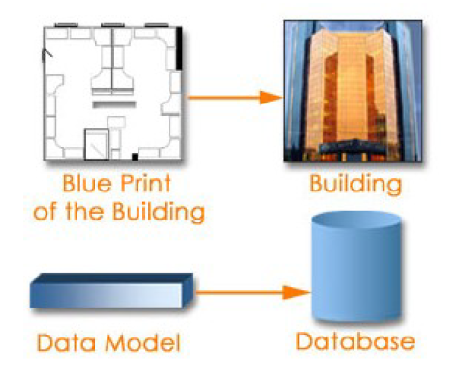
Data Model

Slide 31
Data Models
Data Model:
A set of concepts to describe the structure of a database, the operations for manipulating these structures, and certain constraints that the database should obey.
Data Model Structure and Constraints:
Constructs are used to define the database structure
Constructs typically include elements (and their data types) as well as groups of elements (e.g. entity, record, table), and relationships among such groups
Constraints specify some restrictions on valid data; these constraints must be enforced at all times

Slide 32
Data Models (continued)
Data Model Operations:
These operations are used for specifying database retrievals and updates by referring to the constructs of the data model.
Operations on the data model may include basic model operations (e.g. generic insert, delete, update) and user-defined operations (e.g. compute_student_gpa, update_inventory)

Slide 33
Categories of Data Models
Conceptual (high-level, semantic) data models:
Provide concepts that are close to the way many users perceive data.
(Also called entity-based or object-based data models.)
Physical (low-level, internal) data models:
Provide concepts that describe details of how data is stored in the computer. These are usually specified in an ad-hoc manner through DBMS design and administration manuals
Implementation (representational) data models:
Provide concepts that fall between the above two, used by many commercial DBMS implementations (e.g. relational data models used in many commercial systems).

Slide 34
Schemas versus Instances
Database Schema:
The description of a database.
Includes descriptions of the database structure, data types, and the constraints on the database.
Schema Diagram:
An illustrative display of (most aspects of) a database schema.
Schema Construct:
A component of the schema or an object within the schema, e.g., STUDENT, COURSE.

Slide 35
Schemas versus Instances
Database State:
The actual data stored in a database at a particular moment in time. This includes the collection of all the data in the database.
Also called database instance (or occurrence or snapshot).
The term instance is also applied to individual database components, e.g. record instance, table instance, entity instance

Slide 36
Database Schema vs. Database State
Database State:
Refers to the content of a database at a moment in time.
Initial Database State:
Refers to the database state when it is initially loaded into the system.
Valid State:
A state that satisfies the structure and constraints of the database.

Slide 37
Database Schema vs. Database State (continued)
Distinction
The database schema changes very infrequently.
The database state changes every time the database is updated.
Schema is also called intension.
State is also called extension.

Slide 38
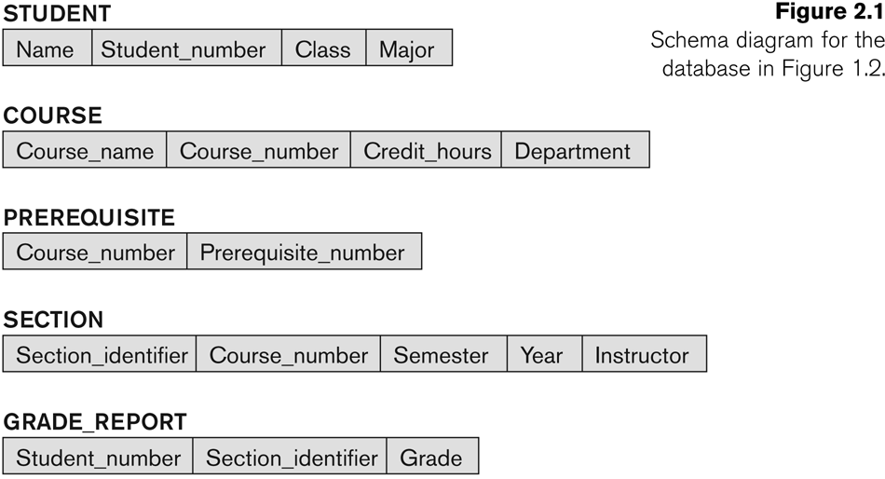
Example of a Database Schema

Slide 39
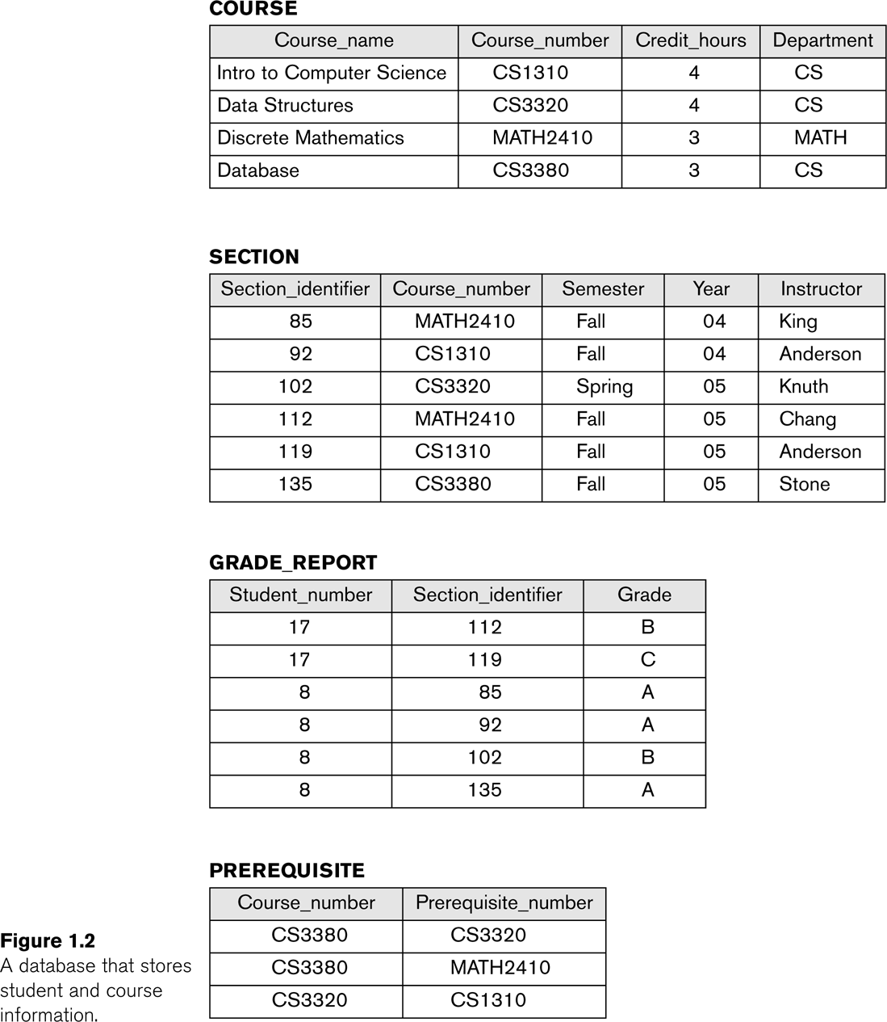
Example of a database state

Slide 40
Three-Schema Architecture
Proposed to support DBMS characteristics of:
Program-data independence.
Support of multiple views of the data.
Not explicitly used in commercial DBMS products, but has been useful in explaining database system organization

Slide 41
Three-Schema Architecture
Defines DBMS schemas at three levels:
Internal schema at the internal level to describe physical storage structures and access paths (e.g indexes).
Typically uses a physical data model.
Conceptual schema at the conceptual level to describe the structure and constraints for the whole database for a community of users.
Uses a conceptual or an implementation data model.
External schemas at the external level to describe the various user views.
Usually uses the same data model as the conceptual schema.

Slide 42
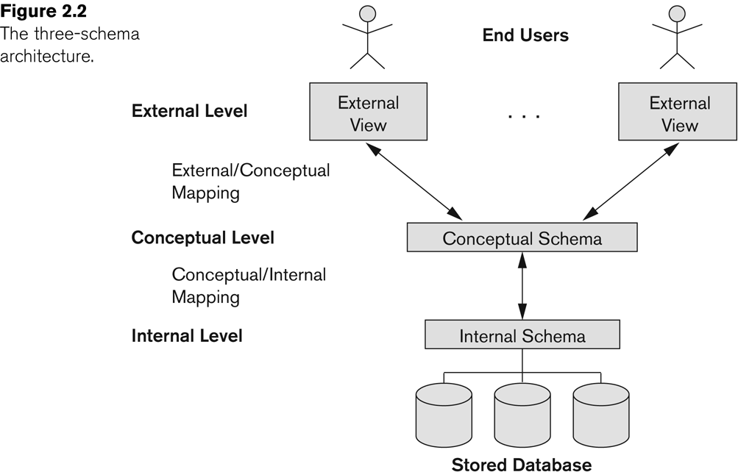
The three-schema architecture

Slide 43
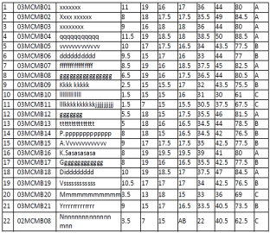
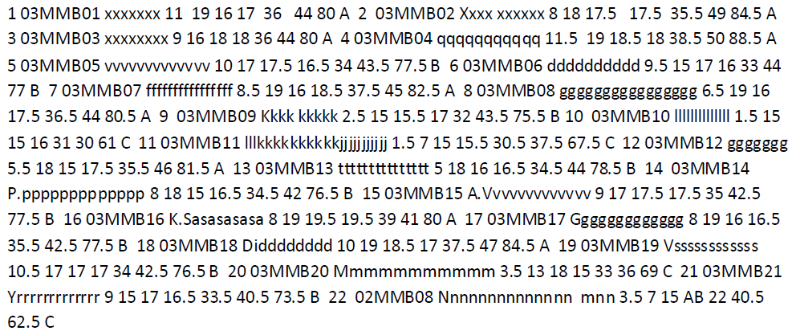
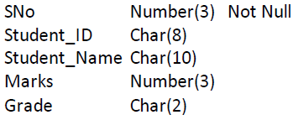
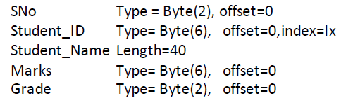
The three-schema architecture
Dean
Faculty
TA
Student
Defines DBMS schemas at three levels:
External schemas at the external level to describe the various user views.
Usually uses the same data model as the conceptual schema.
Conceptual schema at the conceptual level to describe the structure and constraints for the whole database for a community of users.
Uses a conceptual or an implementation data model.
Internal schema at the internal level to describe physical storage structures and access paths (e.g indexes).
Typically uses a physical data model.

Slide 44
Three-Schema Architecture
Mappings among schema levels are needed to transform requests and data.
Programs refer to an external schema, and are mapped by the DBMS to the internal schema for execution.
Data extracted from the internal DBMS level is reformatted to match the user’s external view (e.g. formatting the results of an SQL query for display in a Web page)

Slide 45
Data Independence
Logical Data Independence:
The capacity to change the conceptual schema without having to change the external schemas and their associated application programs.
Physical Data Independence:
The capacity to change the internal schema without having to change the conceptual schema.
For example, the internal schema may be changed when certain file structures are reorganized or new indexes are created to improve database performance

Slide 46
Data Independence (continued)
When a schema at a lower level is changed, only the mappings between this schema and higher-level schemas need to be changed in a DBMS that fully supports data independence.
The higher-level schemas themselves are unchanged.
Hence, the application programs need not be changed since they refer to the external schemas.

Slide 47
DBMS Languages
Data Definition Language (DDL)
Data Manipulation Language (DML)
High-Level or Non-procedural Languages: These include the relational language SQL
May be used in a standalone way or may be embedded in a programming language
Low Level or Procedural Languages:
These must be embedded in a programming language

Slide 48
DBMS Languages
Data Definition Language (DDL):
Used by the DBA and database designers to specify the conceptual schema of a database.
In many DBMSs, the DDL is also used to define internal and external schemas (views).
In some DBMSs, separate storage definition language (SDL) and view definition language (VDL) are used to define internal and external schemas.
SDL is typically realized via DBMS commands provided to the DBA and database designers

Slide 49
DBMS Languages
Data Manipulation Language (DML):
Used to specify database retrievals and updates
DML commands (data sublanguage) can be embedded in a general-purpose programming language (host language), such as COBOL, C, C++, or Java.
A library of functions can also be provided to access the DBMS from a programming language
Alternatively, stand-alone DML commands can be applied directly (called a query language).

Slide 50
Types of DML
High Level or Non-procedural Language:
For example, the SQL relational language
Are “set”-oriented and specify what data to retrieve rather than how to retrieve it.
Also called declarative languages.
Low Level or Procedural Language:
Retrieve data one record-at-a-time;
Constructs such as looping are needed to retrieve multiple records, along with positioning pointers.

Slide 51
DBMS Interfaces
Stand-alone query language interfaces
Example: Entering SQL queries at the DBMS interactive SQL interface (e.g. SQL*Plus in ORACLE)
Programmer interfaces for embedding DML in programming languages
User-friendly interfaces
Menu-based, forms-based, graphics-based, etc.

Slide 52
DBMS Programming Language Interfaces
Programmer interfaces for embedding DML in a programming languages:
Embedded Approach: e.g embedded SQL (for C, C++, etc.), SQLJ (for Java)
Procedure Call Approach: e.g. JDBC for Java, ODBC for other programming languages
Database Programming Language Approach: e.g. ORACLE has PL/SQL, a programming language based on SQL; language incorporates SQL and its data types as integral components

Slide 53
User-Friendly DBMS Interfaces
Menu-based, popular for browsing on the web
Forms-based, designed for naïve users
Graphics-based
(Point and Click, Drag and Drop, etc.)
Natural language: requests in written English
Combinations of the above:
For example, both menus and forms used extensively in Web database interfaces

Slide 54
Other DBMS Interfaces
Speech as Input and Output
Web Browser as an interface
Parametric interfaces, e.g., bank tellers using function keys.
Interfaces for the DBA:
Creating user accounts, granting authorizations
Setting system parameters
Changing schemas or access paths

Slide 55
Database System Utilities
To perform certain functions such as:
Loading data stored in files into a database. Includes data conversion tools.
Backing up the database periodically on tape.
Reorganizing database file structures.
Report generation utilities.
Performance monitoring utilities.
Other functions, such as sorting, user monitoring, data compression, etc.

Slide 56
Other Tools
Data dictionary / repository:
Used to store schema descriptions and other information such as design decisions, application program descriptions, user information, usage standards, etc.
Active data dictionary is accessed by DBMS software and users/DBA.
Passive data dictionary is accessed by users/DBA only.

Slide 57
Other Tools
Application Development Environments and CASE (computer-aided software engineering) tools:
Examples:
PowerBuilder (Sybase)
JBuilder (Borland)
JDeveloper 10G (Oracle)

Slide 58
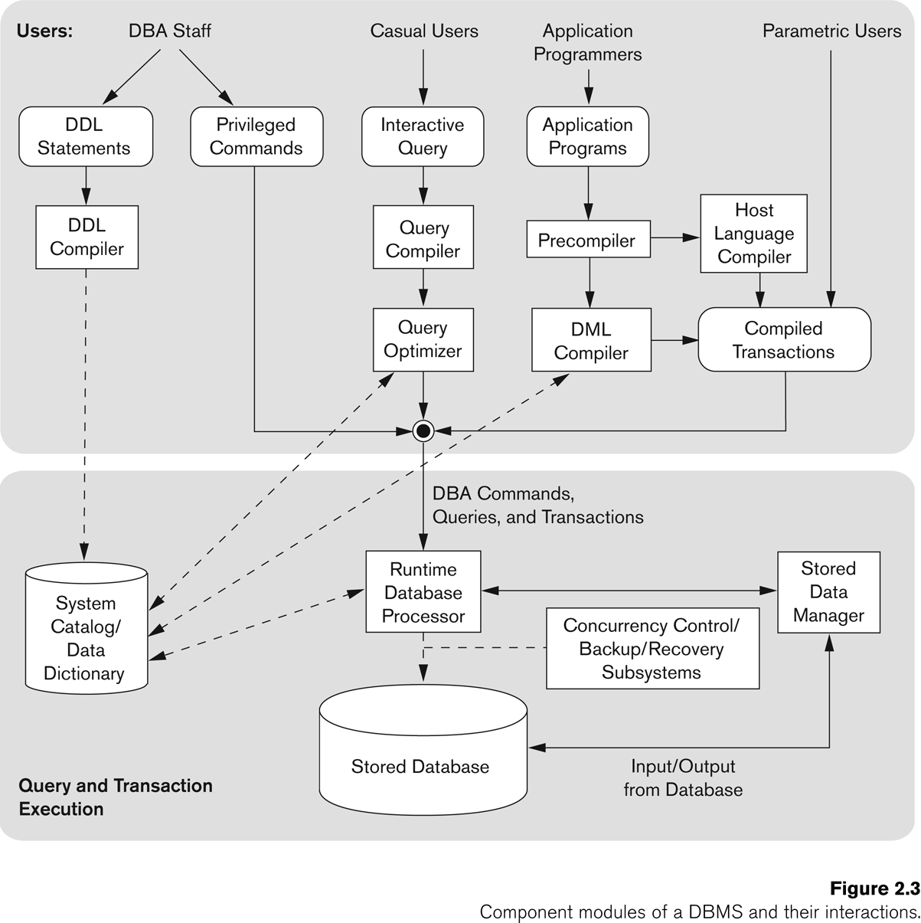
Typical DBMS Component Modules

Slide 59
Centralized and Client-Server DBMS Architectures
Centralized DBMS:
Combines everything into single system including- DBMS software, hardware, application programs, and user interface processing software.
User can still connect through a remote terminal – however, all processing is done at centralized site.

Slide 60
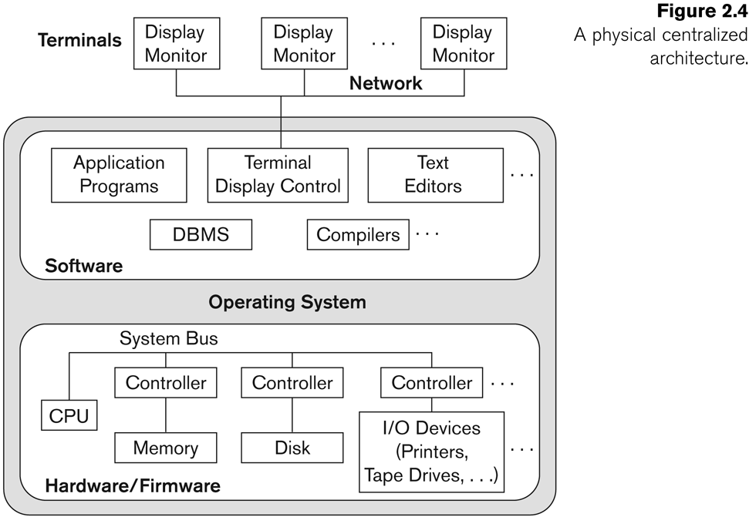
A Physical Centralized Architecture

Slide 61
Basic 2-tier Client-Server Architectures
Specialized Servers with Specialized functions
Print server
File server
DBMS server
Web server
Email server
Clients can access the specialized servers as needed

Slide 62
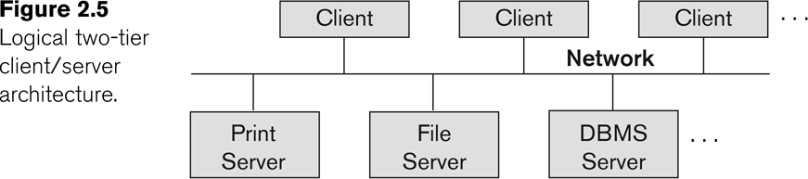
Logical two-tier client server architecture

Slide 63
Clients
Provide appropriate interfaces through a client software module to access and utilize the various server resources.
Clients may be diskless machines or PCs or Workstations with disks with only the client software installed.
Connected to the servers via some form of a network.
(LAN: local area network, wireless network, etc.)

Slide 64
DBMS Server
Provides database query and transaction services to the clients
Relational DBMS servers are often called SQL servers, query servers, or transaction servers
Applications running on clients utilize an Application Program Interface (API) to access server databases via standard interface such as:
ODBC: Open Database Connectivity standard
JDBC: for Java programming access
Client and server must install appropriate client module and server module software for ODBC or JDBC

Slide 65
Two Tier Client-Server Architecture
A client program may connect to several DBMSs, sometimes called the data sources.
In general, data sources can be files or other non-DBMS software that manages data.
Other variations of clients are possible: e.g., in some object DBMSs, more functionality is transferred to clients including data dictionary functions, optimization and recovery across multiple servers, etc.

Slide 66
Three Tier Client-Server Architecture
Common for Web applications
Intermediate Layer called Application Server or Web Server:
Stores the web connectivity software and the business logic part of the application used to access the corresponding data from the database server
Acts like a conduit for sending partially processed data between the database server and the client.
Three-tier Architecture Can Enhance Security:
Database server only accessible via middle tier
Clients cannot directly access database server

Slide 67
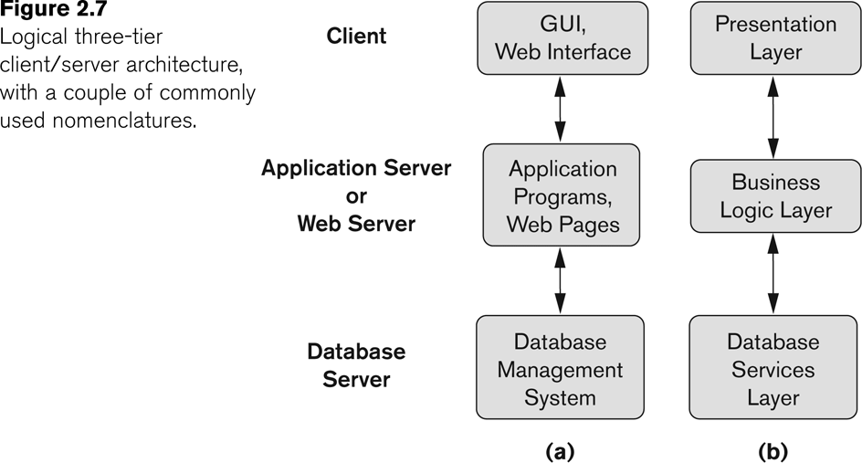
Three-tier client-server architecture

Slide 68
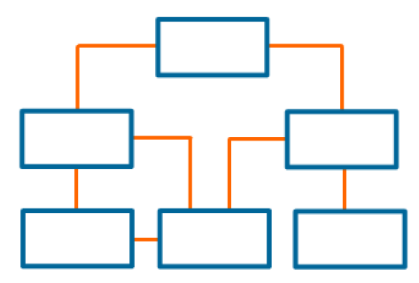
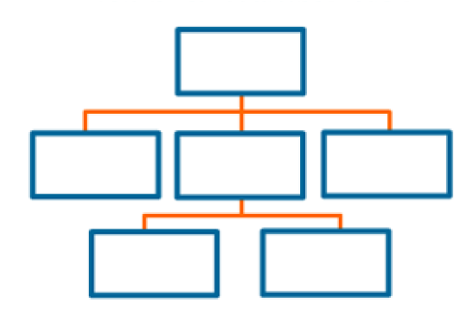
Classification of DBMSs
Based on the data model used
Traditional: Relational, Network, Hierarchical.
Emerging: Object-oriented, Object-relational.
Relational
Network
Hierarchical

Slide 69
Classification of DBMSs
Based on the data model used
Traditional: Relational, Network, Hierarchical.
Emerging: Object-oriented, Object-relational.
Other classifications
Single-user (typically used with personal computers) vs. multi-user (most DBMSs).
Centralized (uses a single computer with one database) vs. distributed (uses multiple computers, multiple databases)

Slide 70
Variations of Distributed DBMSs (DDBMSs)
Homogeneous DDBMS
Heterogeneous DDBMS
Federated or Multidatabase Systems
Distributed Database Systems have now come to be known as client-server based database systems because:
They do not support a totally distributed environment, but rather a set of database servers supporting a set of clients.

Slide 71
Cost considerations for DBMSs
Cost Range: from free open-source systems to configurations costing millions of dollars
Examples of free relational DBMSs: MySQL, PostgreSQL, others
Commercial DBMS offer additional specialized modules, e.g. time-series module, spatial data module, document module, XML module
These offer additional specialized functionality when purchased separately
Sometimes called cartridges (e.g., in Oracle) or blades
Different licensing options: site license, maximum number of concurrent users (seat license), single user, etc.

Slide 72
QUIZ
What is a Data Model?
a) A description of a Database
b) A set of concepts for describing database
c) A representation of three-schema architecture
d) A description of internal schema

Slide 73
QUIZ
What is a Database Schema?
a) A description of internal schema
b) A set of concepts for describing database
c) A representation of three-schema architecture
d) A description of a database using a specific data model

Slide 74
QUIZ
What is Intension?
a) data model
b) database schema
c) schema diagram
d) database state

